Slide 1
UNICORN COMPANIES REPRESENTATION IN DIFFERENT CITIES, COUNTRIES AND CONTINENTS
By
Ugochi Sonia Audu

Slide 2
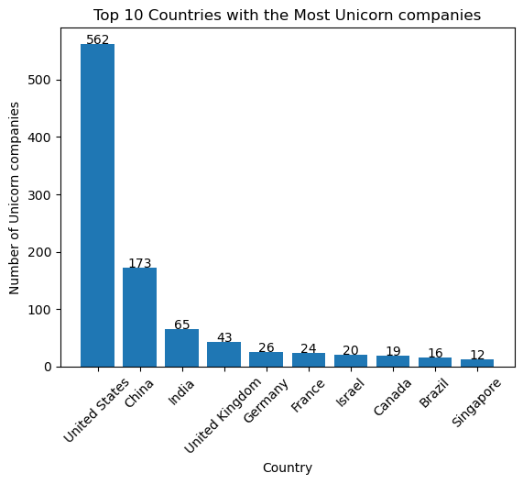
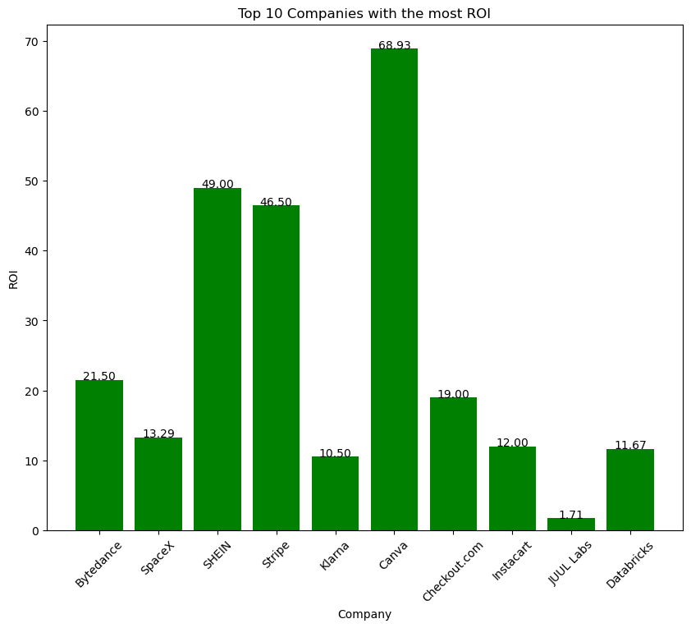
TOP 10 COUNTRIES WITH THE MOST UNICORNS AND ROI
Findings: United state has the highest listing with a total value of 562 while Singapore is the lowest with a total value of 12 amongst the top 10 Unicorn companies.
Findings: As you can see, Canva has had the biggest return on investment, with an ROI of over 68.93% followed by SHEIN, Stripe, Byte dance, Checkout.com, SpaceX, Instacart, Databricks, Klarna and JUUL Labs having the least 1.71.

Slide 3
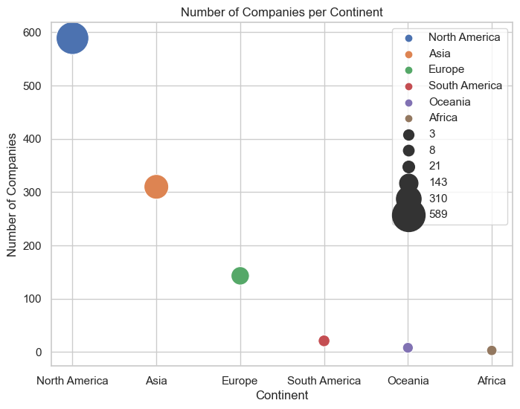
COMPANIES BY CONTINENT
Findings: This means that there are 589 unicorn companies in North America, 310 unicorn companies in Asia, 143 unicorn companies in Europe, 21 unicorn companies in South America, 8 unicorn companies in Oceania and 3 unicorn company in Africa.

Slide 4
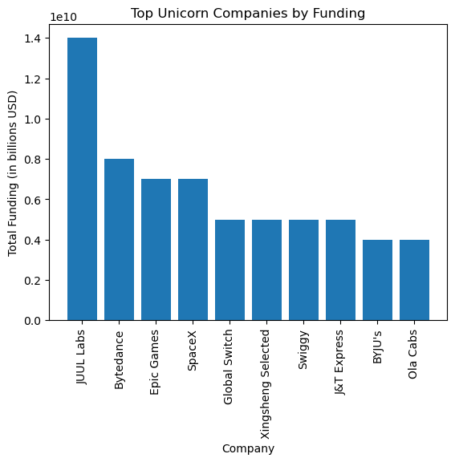
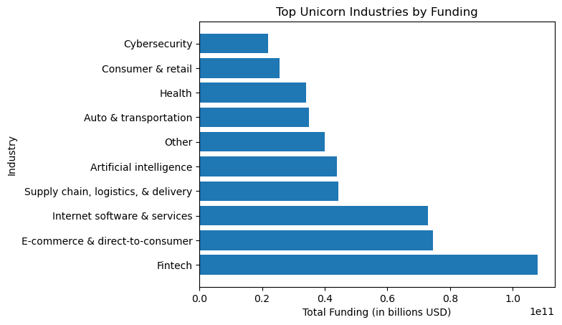
INDUSTRIES AND COMPANIES BY FUNDING
Findings: It is evident that the fintech, software, and e-commerce industries are the top three unicorn industries in terms of funding. These industries are currently experiencing significant growth and have attracted considerable investment.
Findings: JUUL labs , Bytedance ,Epic Games are the highest of top companies by funding while BYJU's and Ola Cabs the least.

Slide 5
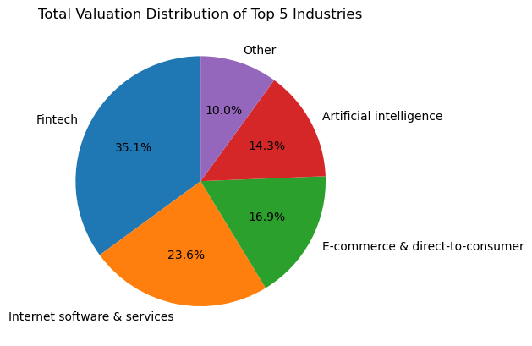
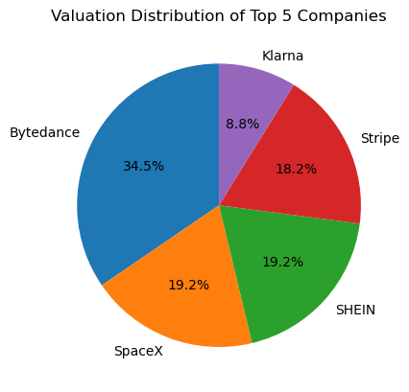
TOP 5 COMPANIES AND INDUSTRIES BY VALUATION
Findings: Fintech, Internet Software & services, E-commerce& direct-to-consumer, Artificial intelligence and others having 10% are the top 5 Industries by Valuation.
Findings: Bytedance, SpaceX, SHEIN, Stripe and Klarna are the top 5 companies ranked by their valuation.

Slide 6
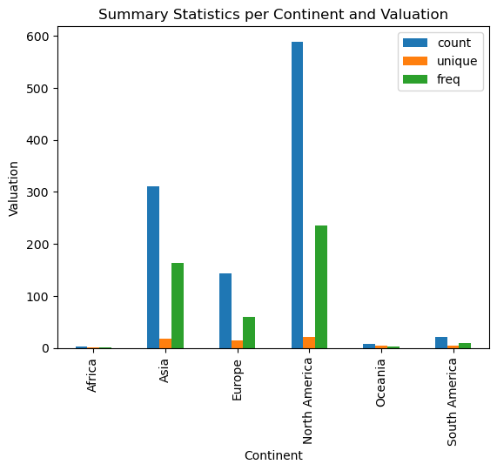
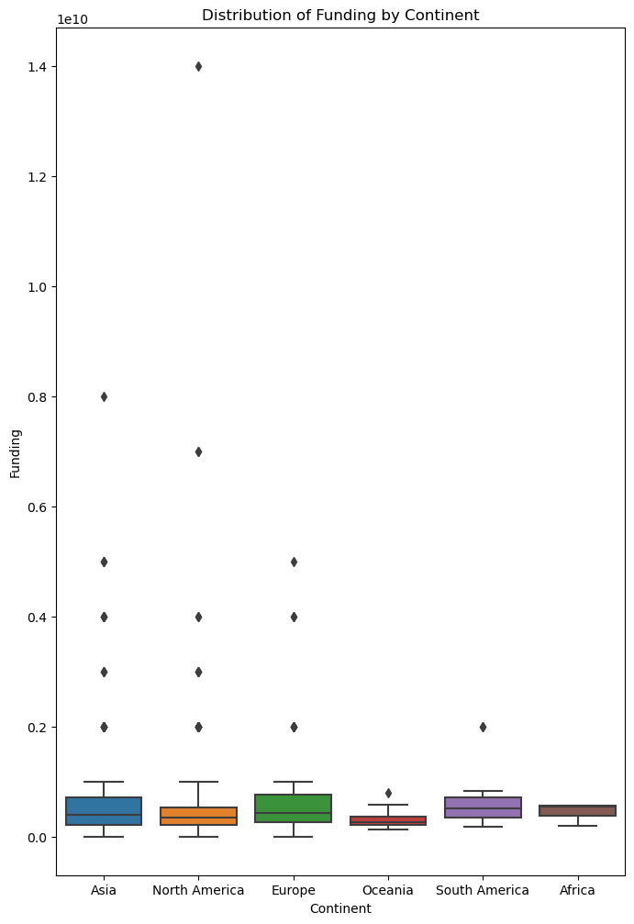
FUNDING AND VALUATION BY CONTINENT
Findings: The average valuation of unicorns differs considerably across continents. North America has the highest average valuation, followed by Asia, Europe, South America, Africa, and Australia and Oceania.
Findings: North America has the highest funding with a total count of 589 counts by Continent while Africa has the lowest funding with the total value of 3.0 counts.

Slide 7
RECOMMENDATION
To achieve success, unicorn companies should prioritize innovation by continuously developing new products and services that cater to their customers' needs. To stay ahead of the competition, stakeholders should invest in research and development with would boost their return on investment.
In addition to innovation, it would need to draw up a strong business model considering the uniqueness of its market i.e Fintech Unicorns in Africa and South America would have to develop means of reaching individual at the bottom of the pyramid.
Also, unicorn companies need to expand into new markets, tapping into a more extensive potential customer base. Stakeholders should also consider expansion into new markets to grow their business and increase revenue.
Unicorn companies have strong brands that are trusted by their customers, and they can invest in building their brand through advertising, public relations, and other marketing activities. Stakeholders should continue to invest in building a strong brand to attract new customers and retain existing ones.
The company's management team and staff should aim to recruit a diverse group of leaders with expertise in relevant fields, who can effectively pursue the company's objectives and goals, while being supported by highly skilled and capable staff i.e., stakeholders should ensure that their customer service is top-notch to keep their customers satisfied and loyal.

